Slide 1
Lecture 3 Introduction to CSS
Nisar Ahmed Siddiqui
Lecturer Computer Science

Slide 2
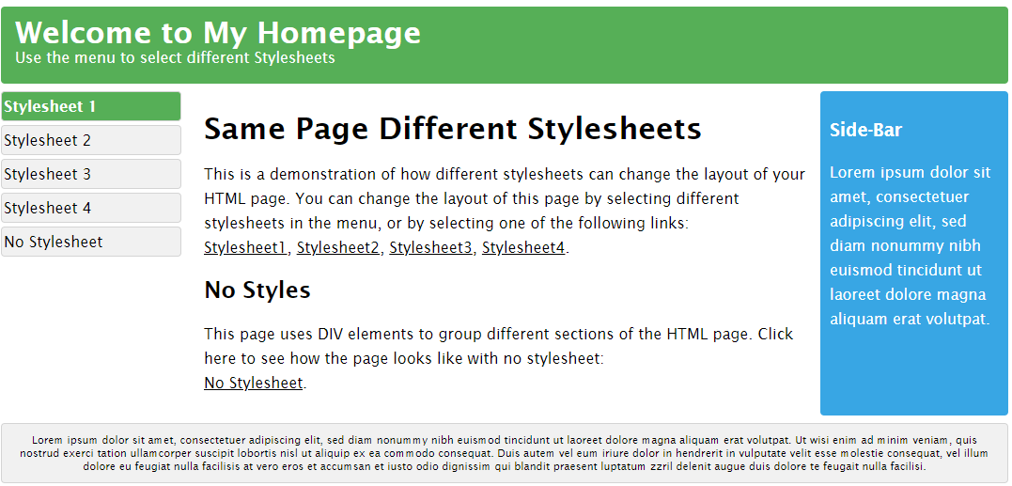
What is CSS? (Cascading Style Sheet)
CSS stands for Cascading Style Sheets
CSS describes how HTML elements are to be displayed on screen, paper, or in other media
CSS saves a lot of work. It can control the layout of multiple web pages all at once
External stylesheets are stored in CSS files

Slide 3
Why use css?
HTML was NEVER intended to contain tags for formatting a web page!
HTML was created to describe the content of a web page, like:
<h1>This is a heading</h1>
<p>This is a paragraph.</p>
When tags like <font>, and color attributes were added to the HTML 3.2 specification, it started a nightmare for web developers. Development of large websites, where fonts and color information were added to every single page, became a long and expensive process.
To solve this problem, the World Wide Web Consortium (W3C) created CSS.
CSS removed the style formatting from the HTML page!

Slide 4
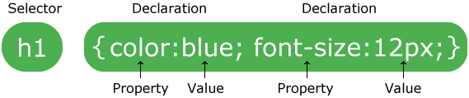
CSS
A CSS rule consists of a selector and a declaration block:
The selector points to the HTML element to style (h1).
The declaration block (in curly braces) contains one or more declarations separated by semicolons.
Each declaration includes a CSS property name and a value, separated by a colon.
In the following example all <p> elements will be 32px wide, center-aligned, and with red:

Slide 5
CSS Selectors
CSS selectors are used to "find" (or select) the HTML elements you want to style.
We can divide CSS selectors into five categories:
Simple selectors (select elements based on name, id, class)
Combinators Selector (select elements based on a specific relationship between them)
Pseudo-class Selectors (select elements based on a certain state)
Pseudo-elements Selectors(select and style a part of an element)
Attribute Selectors(select elements based on an attribute or attribute value)

Slide 6
Simple Selectors
CSS element Selector
The element selector selects HTML elements based on the element name.
p { text-align: center; color: red; }

Slide 7
Simple Selectors
CSS id Selector
The id selector uses the id attribute of an HTML element to select a specific element.
The id of an element is unique within a page, so the id selector is used to select one unique element!
#id { text-align: center; color: red; }

Slide 8
Simple Selectors
CSS class Selector
The class selector selects HTML elements with a specific class attribute.
.class { text-align: center; color: red; }

Slide 9
Simple Selectors
CSS element class Selector
You can also specify that only specific HTML elements should be affected by a class.
p.class { text-align: center; color: red; }

Slide 10
Simple Selectors
CSS Universal Selector
The universal selector (*) selects all HTML elements on the page
* { text-align: center; color: red; }

Slide 11
Simple Selectors
The CSS Grouping Selector
The grouping selector selects all the HTML elements with the same style definitions.
P, h1, h2, div { text-align: center; color: red; }

Slide 12
Combinators Selectors
A CSS selector can contain more than one simple selector. Between the simple selectors, we can include a combinator.
There are four different combinators in CSS:
descendant selector (space)
child selector (>)
adjacent sibling selector (+)
general sibling selector (~)

Slide 13
Combinators Selectors
Descendant Selector
The descendant selector matches all elements that are descendants of a specified element.
The following example selects all <p> elements inside <div> elements:
div p { background-color: yellow; }

Slide 14
Combinators Selectors
Child Selector (>)
The child selector selects all elements that are the children of a specified element.
The following example selects all <p> elements that are children of a <div> element:
Div > p { background-color: yellow; }

Slide 15
Combinators Selectors
Adjacent Sibling Selector (+)
The adjacent sibling selector is used to select an element that is directly after another specific element.
Sibling elements must have the same parent element, and "adjacent" means "immediately following".
div + p { background-color: yellow; }

Slide 16
Combinators Selectors
General Sibling Selector (~)
The general sibling selector selects all elements that are next siblings of a specified element.
The following example selects all <p> elements that are next siblings of <div> elements: :
div ~ p { background-color: yellow; }

Slide 17
CSS Pseudo-classes Selectors
A pseudo-class is used to define a special state of an element.
For example, it can be used to:
Style an element when a user mouses over it
Style visited and unvisited links differently
Style an element when it gets focus

Slide 18
CSS Pseudo-classes Selectors
Syntax
selector:pseudo-class {
property: value; }

Slide 19
CSS Pseudo-classes Selectors
Anchor Pseudo-classes
/* unvisited link */ a:link { color: #FF0000; } /* visited link */ a:visited { color: #00FF00; }
/* mouse over link */ a:hover { color: #FF00FF; } /* selected link */ a:active { color: #0000FF; }

Slide 20
CSS Pseudo-classes Selectors
Pseudo-classes and CSS Classes
a.highlight: hover { color: #ff0000; }

Slide 21
CSS Pseudo-classes Selectors
Hover on <div>
div:hover { background-color: blue; }

Slide 22
CSS Pseudo-classes Selectors
CSS - The :first-child Pseudo-class
The :first-child pseudo-class matches a specified element that is the first child of another element.
p:first-child { color: blue; }
In the following example, the selector matches any <p> element that is the first child of any element.

Slide 23
CSS Pseudo-classes Selectors
Match the first <i> element in all <p> elements
p i:first-child { color: blue; }
In the following example, the selector matches the first <i> element in all <p> elements

Slide 24
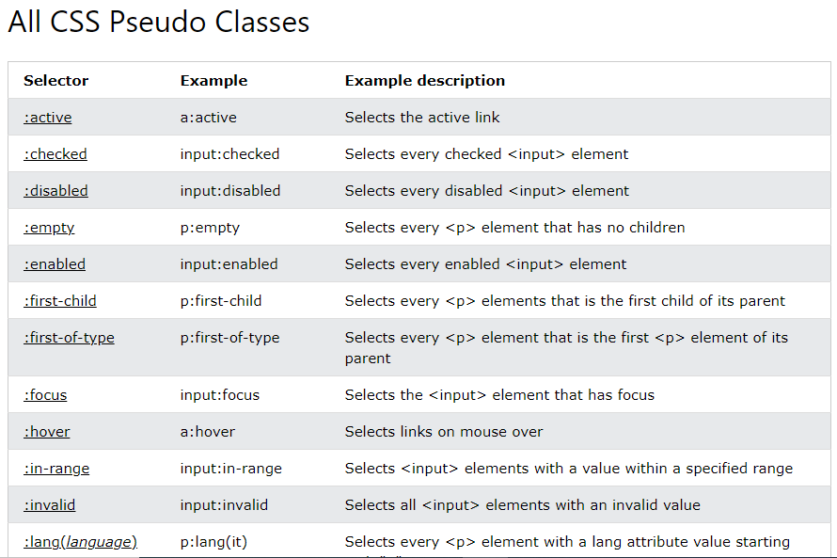

Slide 25
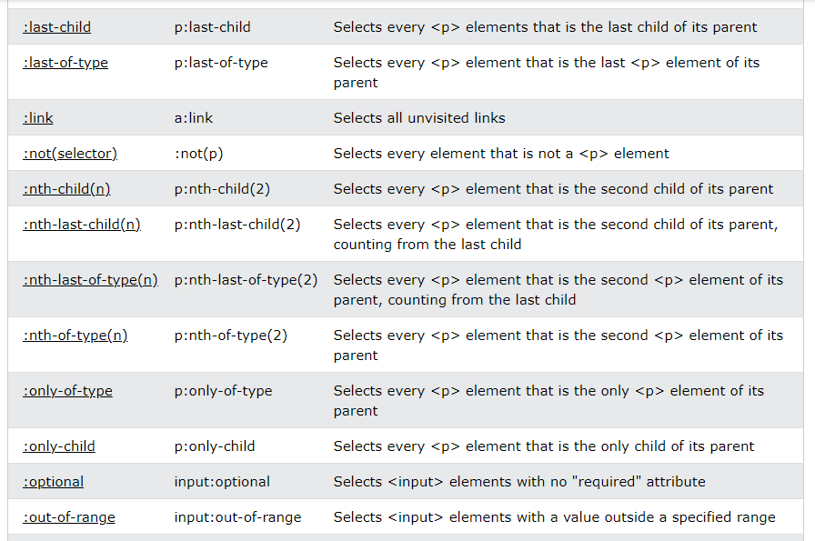

Slide 26
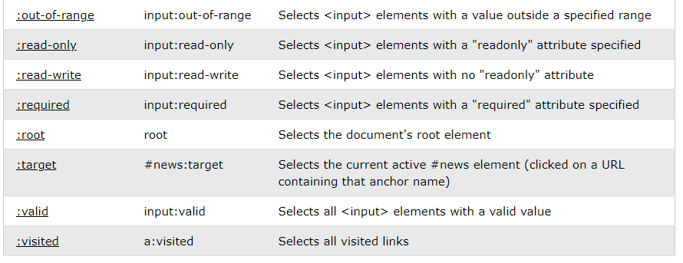

Slide 27
CSS Pseudo-Element Selectors
A CSS pseudo-element is used to style specified parts of an element.
For example, it can be used to:
Style the first letter, or line, of an element
Insert content before, or after, the content of an element

Slide 28
CSS Pseudo-Element Selectors
The syntax of pseudo-elements:
selector::pseudo-element {
property: value; }

Slide 29
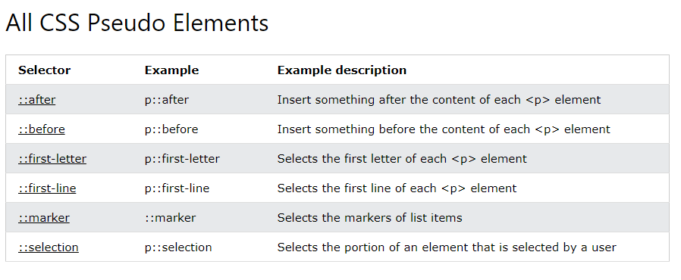

Slide 30
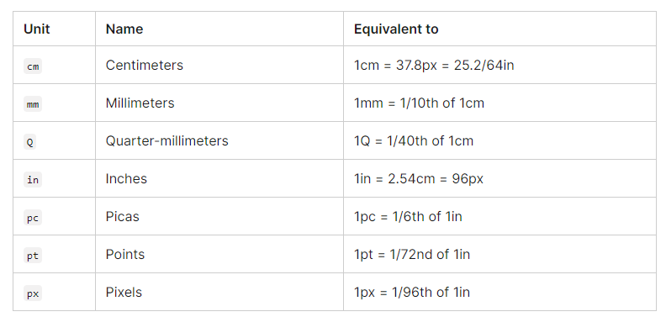
CSS Properties
Length Units

Slide 31
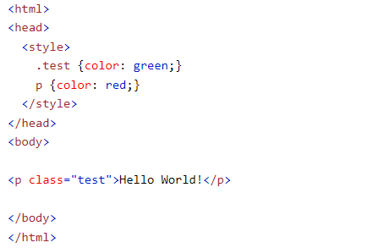
Specificity
What is Specificity?
If there are two or more CSS rules that point to the same element, the selector with the highest specificity value will "win", and its style declaration will be applied to that HTML element.
In this example, we have added a class selector (named "test"), and specified a green color for this class. The text will now be green (even though we have specified a red color for the element selector "p"). This is because the class selector is given higher priority

Slide 32
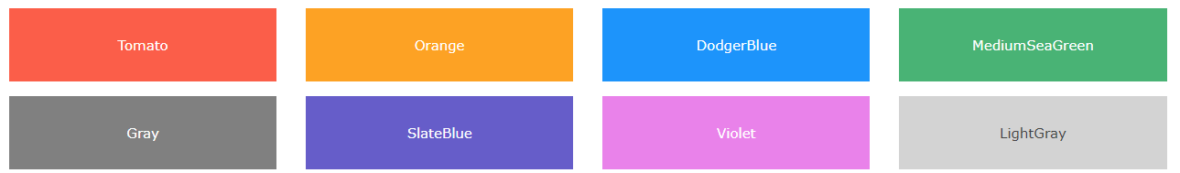

CSS – Colors
CSS Color Values
In CSS, colors can also be specified using RGB values, HEX values, HSL values, RGBA values, and HSLA values:
Same as color name "Tomato":
Notes:
Color Code Reference : https://www.w3.org/wiki/CSS/Properties/color/keywords

Slide 33
CSS Margins
The CSS margin properties are used to create space around elements, outside of any defined borders.
With CSS, you have full control over the margins. There are properties for setting the margin for each side of an element (top, right, bottom, and left).

Slide 34
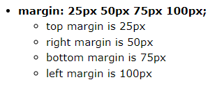
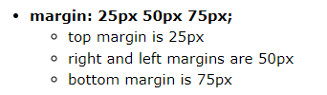



Margin - Individual Sides
CSS has properties for specifying the margin for each side of an element:
margin-top
margin-right
margin-bottom
margin-left
All the margin properties can have the following values:
auto - the browser calculates the margin
length - specifies a margin in px, pt, cm, etc.
% - specifies a margin in % of the width of the containing element
inherit - specifies that the margin should be inherited from the parent element

Slide 35
CSS - Paddings
Paddings are same as margins, as both have the same attributes, the only difference between both is that paddings cannot be negative.

Slide 36
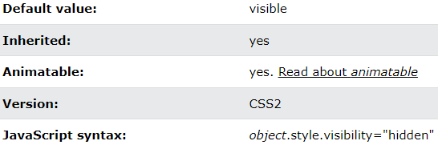
Visibility Property
The visibility property specifies whether or not an element is visible.
Syntax:
Tip: Hidden elements take up space on the page. Use the display property to both hide and remove an element from the document layout!

Slide 37
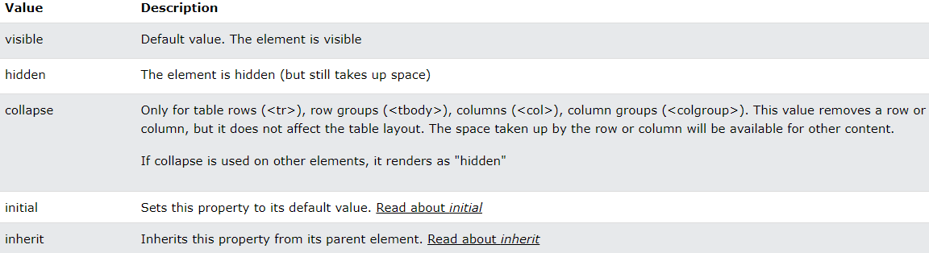
Visibility Property – contd…
Property Values

Slide 38
Element Flow in HTML and CSS
Every HTML element has a default display value, depending on what type of element it is.
There are two display values: block and inline.

Slide 39
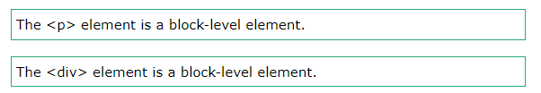
Block-level Elements
A block-level element always starts on a new line, and the browsers automatically add some space (a margin) before and after the element.
A block-level element always takes up the full width available (stretches out to the left and right as far as it can).
Two commonly used block elements are: <p> and <div>.
The <p> element defines a paragraph in an HTML document.
The <div> element defines a division or a section in an HTML document.

Slide 40
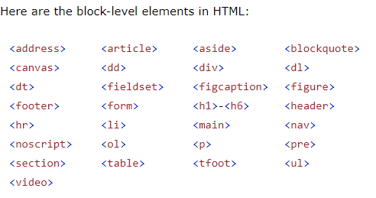
Block Level Elements

Slide 41

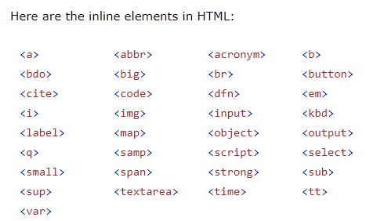
Inline Elements
An inline element does not start on a new line.
An inline element only takes up as much width as necessary.

Slide 42
CSS - Float
The CSS float property specifies how an element should float.
The CSS clear property specifies what elements can float beside the cleared element and on which side.

Slide 43
The float Property
The float property is used for positioning and formatting content e.g. let an image float left to the text in a container.
The float property can have one of the following values:
left - The element floats to the left of its container
right - The element floats to the right of its container
none - The element does not float (will be displayed just where it occurs in the text). This is default
inherit - The element inherits the float value of its parent
In its simplest use, the float property can be used to wrap text around images.

Slide 44
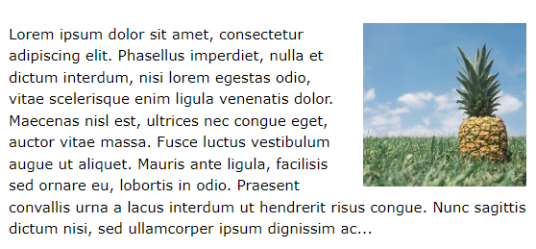

Example - float: right;
The following example specifies that an image should float to the right in a text:
Syntax: output:

Slide 45
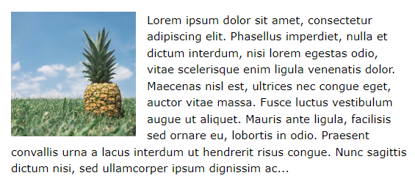

Example - float: left;
The following example specifies that an image should float to the left in a text:
Syntax: Output:

Slide 46
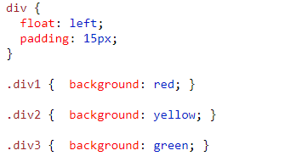
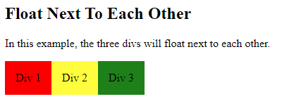
Example - Float Next To Each Other
Normally div elements will be displayed on top of each other. However, if we use float: left we can let elements float next to each other:
Syntax: Output:

Slide 47
CSS Layout - clear and clearfix
The clear property specifies what should happen with the element that is next to a floating element.
The clear property can have one of the following values:
none - The element is not pushed below left or right floated elements. This is default
left - The element is pushed below left floated elements
right - The element is pushed below right floated elements
both - The element is pushed below both left and right floated elements
inherit - The element inherits the clear value from its parent
Note: When clearing floats, you should match the clear to the float: If an element is floated to the left, then you should clear to the left. Your floated element will continue to float, but the cleared element will appear below it on the web page.

Slide 48
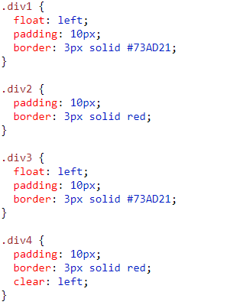
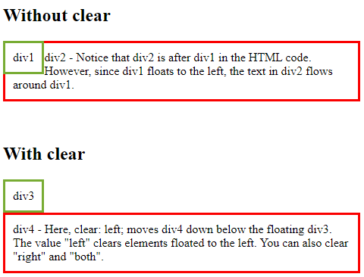
Clear Example

Slide 49

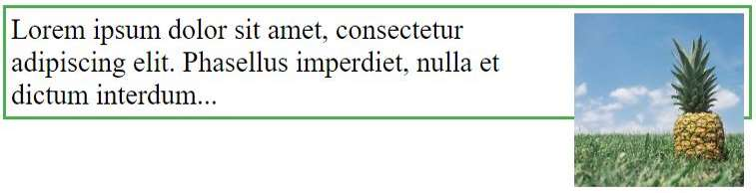
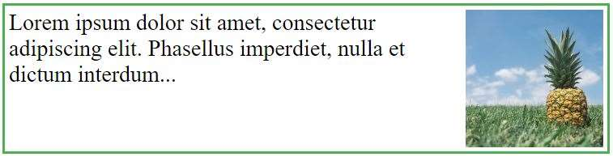
The clearfix Hack
If a floated element is taller than the containing element, it will "overflow" outside of its container. We can then add a clearfix hack to solve this problem:
Without Clear Fix: With Clear Fix:

Slide 50
CSS – FlexBox Model
CSS Flexbox Layout Module
Before the Flexbox Layout module, there were four layout modes:
Block, for sections in a webpage
Inline, for text
Table, for two-dimensional table data
Positioned, for explicit position of an element
The Flexible Box Layout Module, makes it easier to design flexible responsive layout structure without using float or positioning.

Slide 51

Flexbox Elements
To start using the Flexbox model, you need to first define a flex container.
The element above represents a flex container (the blue area) with three flex items.
.flex-container {
display: flex;
background-color: DodgerBlue;
}
.flex-container > div {
background-color: #f1f1f1;
margin: 10px;
padding: 20px;
font-size: 30px;
}
<div class="flex-container">
<div>1</div>
<div>2</div>
<div>3</div>
</div>

Slide 52
FlexBox (cont…)
The flex container properties are:
flex-direction
flex-wrap
flex-flow
justify-content
align-items
align-content

Slide 53
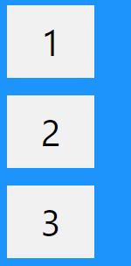

The flex-direction Property
The flex-direction property defines in which direction the container wants to stack the flex items.
Possible values for flex-direction are (column, column-reverse, row, row-reverse)
Syntax: Output:

Slide 54

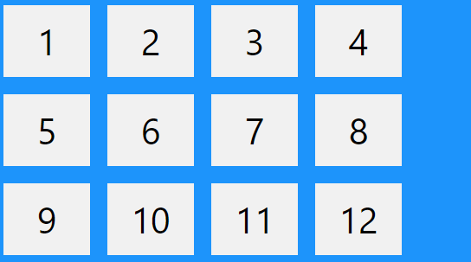
The flex-wrap Property
The flex-wrap property specifies whether the flex items should wrap or not.
The examples below have 12 flex items, to better demonstrate the flex-wrap property.
Syntax: Output:
Possible values for flex-wrap are : (wrap, nowrap, wrap-reverse)

Slide 55

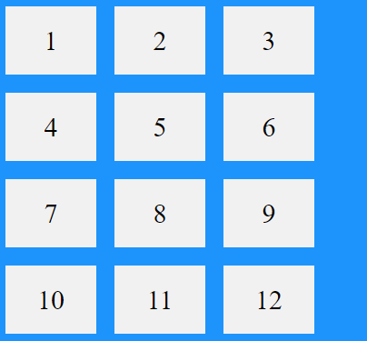
The flex-flow Property
The flex-flow property is a shorthand property for setting both the flex-direction and flex-wrap properties.

Slide 56


The justify-content Property
The justify-content property is used to align the flex items:
Syntax Output:
Possible values for justify-content are : (center, flex-start, flex-end, space-around, space-between)

Slide 57
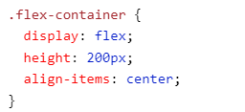

The align-items Property
The align-items property is used to align the flex items
Syntax Output:
Possible values for align-items are : (center, flex-start, flex-end, stretch, baseline)

Slide 58
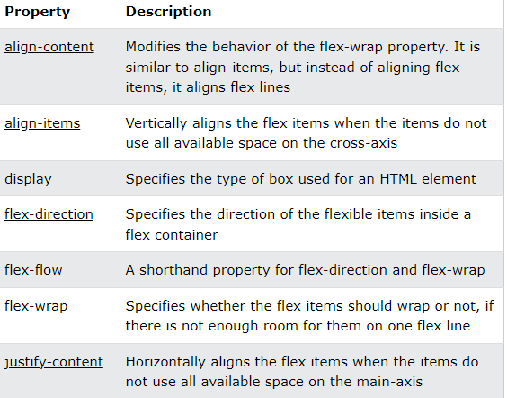
FlexBox properties explained

